Slide 1
Simplifying IoT with IoT Plug and Play
Berry Tsai
2020/12/15

Slide 2
Agenda
Azure IoT 介紹
IoT Plug and Play DEMO
Q and A
Hands on Lab

Slide 4
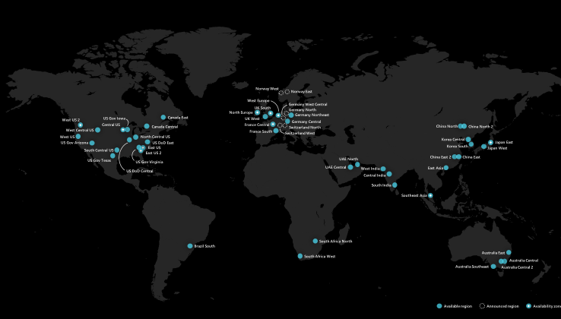
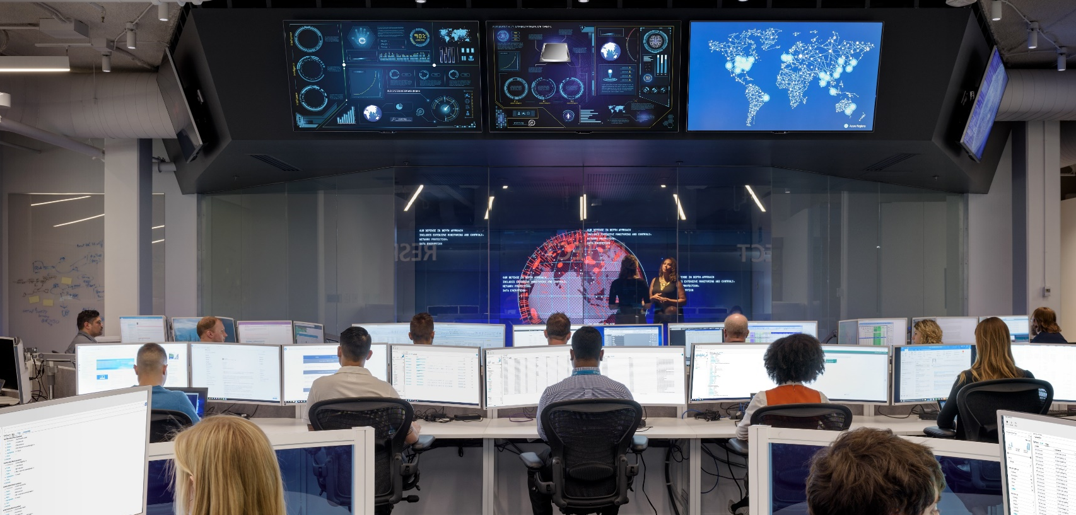
Hybrid
Secure
Compliant
90+
Compliance
Certifications
91
Compliance offerings
GLOBAL
INDUSTRY
REGIONAL
ISO 27001:2013
ISO 27017:2015
ISO 27018:2014
ISO 22301:2012
ISO 9001:2015
ISO 20000-1:2011
SOC 1 Type 2
SOC 2 Type 2
SOC 3
CIS Benchmark
CSA STAR Certification
CSA STAR Attestation
CSA STAR Self-Assessment
WCAG 2.0 (ISO 40500:2012)
Argentina PDPA
Australia IRAP Unclassified
Australia IRAP PROTECTED
Canada Privacy Laws
China GB 18030:2005
China DJCP (MLPS) Level 3
China TRUCS / CCCPPF
EU EN 301 549
EU ENISA IAF
EU Model Clauses
EU – US Privacy Shield
GDPR
Germany C5
Germany IT-Grundschutz workbook
India MeitY
Japan CS Mark Gold
Japan My Number Act
Netherlands BIR 2012
New Zealand Gov CIO Framework
Singapore MTCS Level 3
Spain ENS High
Spain DPA
UK Cyber Essentials Plus
UK G-Cloud
UK PASF
PCI DSS Level 1
GLBA (US)
FFIEC (US)
Shared Assessments (US)
SEC 17a-4 (US)
CFTC 1.31 (US)
FINRA 4511 (US)
SOX (US)
23 NYCRR 500 (US)
OSFI (Canada)
FCA + PRA (UK)
APRA (Australia)
FINMA (Switzerland)
FSA (Denmark)
RBI + IRDAI (India)
MAS + ABS (Singapore)
NBB + FSMA (Belgium)
AFM + DNB (Netherlands)
AMF + ACPR (France)
KNF (Poland)
European Banking Authority (EBA)
FISC (Japan)
HIPAA BAA (US)
HITRUST Certification
GxP (FDA 21 CFR Part 11)
MARS-E (US)
NHS IG Toolkit (UK)
NEN 7510:2011 (Netherlands)
FERPA (US)
CDSA
MPAA (US)
FACT (UK)
DPP (UK)
66
Microsoft Cyber Defense Operations Center
>3,500 full-time security professionals
6.5 trillion global signals daily
$1 billion annual cybersecurity investment
Azure regions
Largest geographical footprint of any cloud provider operating regions in 28 countries on all continents.
Seamless integration and common management of resources across heterogenous and hybrid environments
U.S. GOVT
FedRAMP High
FedRAMP Moderate
EAR
ITAR
DoD DISA SRG Level 5
DoD DISA SRG Level 4
DoD DISA SRG Level 2
DFARS
DoE 10 CFR Part 810
NIST SP 800-171
NIST CSF
Section 508 VPATs
FIPS 140-2
CJIS
IRS 1075
CNSSI 1253
Notes:
Hybrid – largest geographical footprint of any cloud provider with more than 60 Azure regions
Secure – ss
Compliant – 90 plus compliance certifications

Slide 5


Slide 6
Azure is Microsoft’s cloud computing platform
Packaged Software
Infrastructure
(as a Service)
Platform
(as a Service)
Software
(as a Service)
You manage
Applications
Applications
Applications
Applications
Data
You manage
Data
Data
Data
Runtime
Runtime
Runtime
Runtime
Managed by vendor
You Manage manage
Middleware
Middleware
Middleware
Middleware
Managed by vendor
O/S
O/S
O/S
O/S
Virtualization
Virtualization
Managed by vendor
Virtualization
Virtualization
Servers
Servers
Servers
Servers
Storage
Storage
Storage
Storage
Networking
Networking
Networking
Networking
Microsoft 365
Dynamic365
Azure

Slide 7
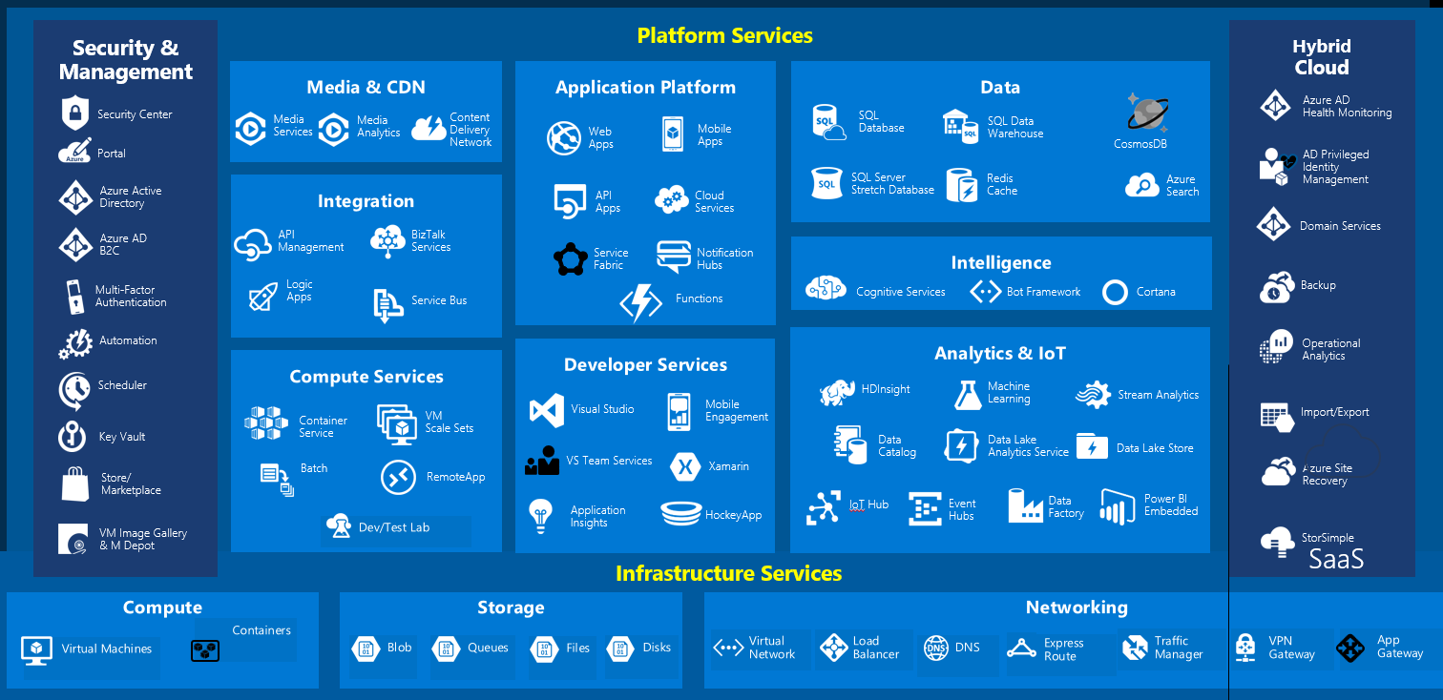
Azure Platform

Slide 8
Azure IoT

Slide 9

MICROSOFT WILL INVEST $5 BILLION IN IoT
Our goal is to give every customer the ability to transform their businesses, and the world at large, with connected solutions.

Slide 10
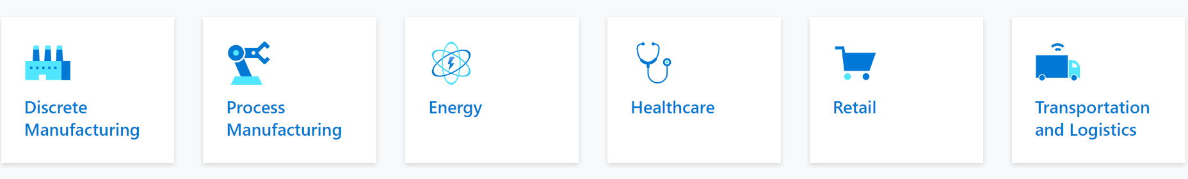
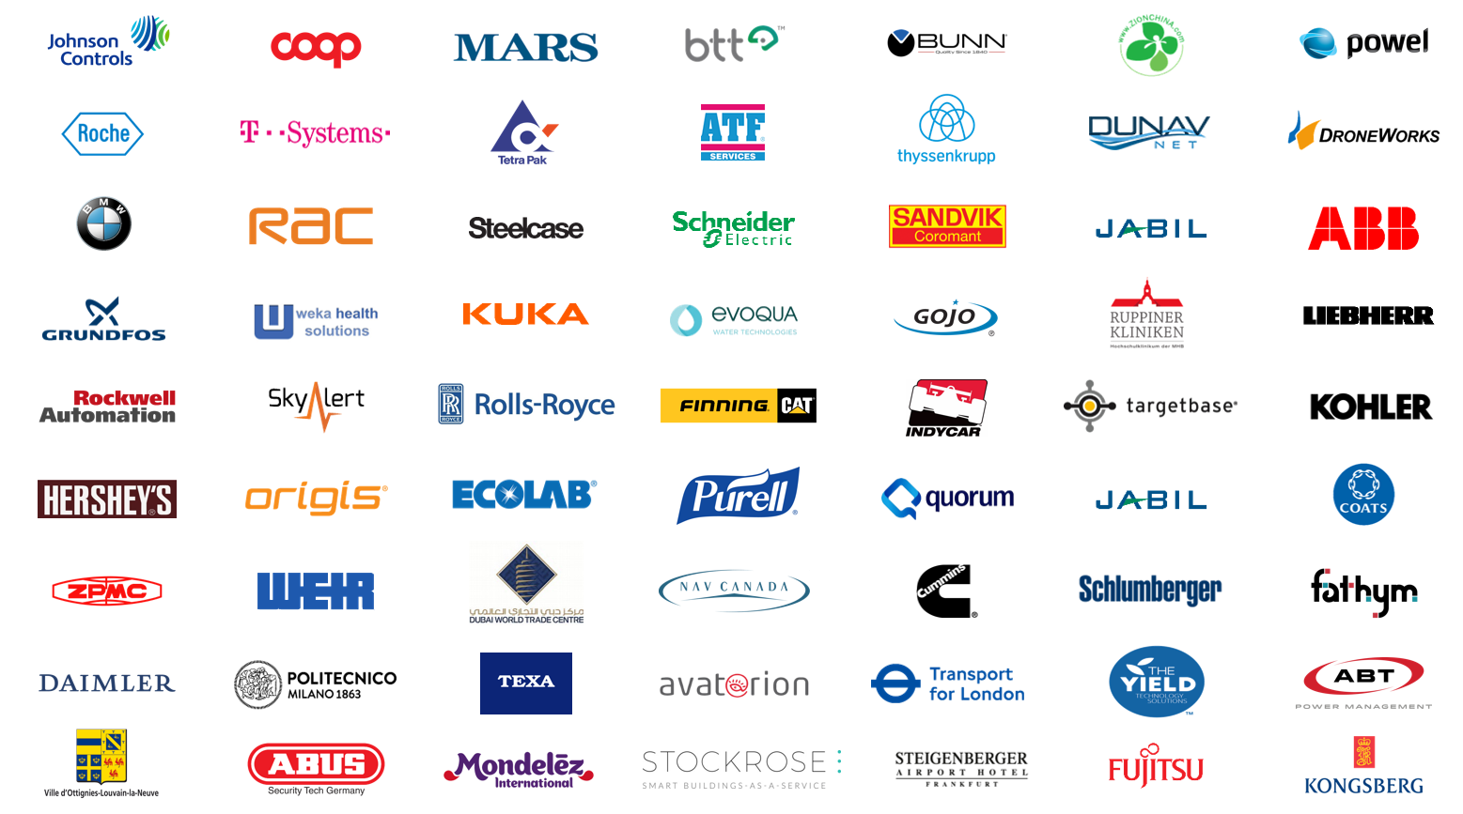

Slide 11
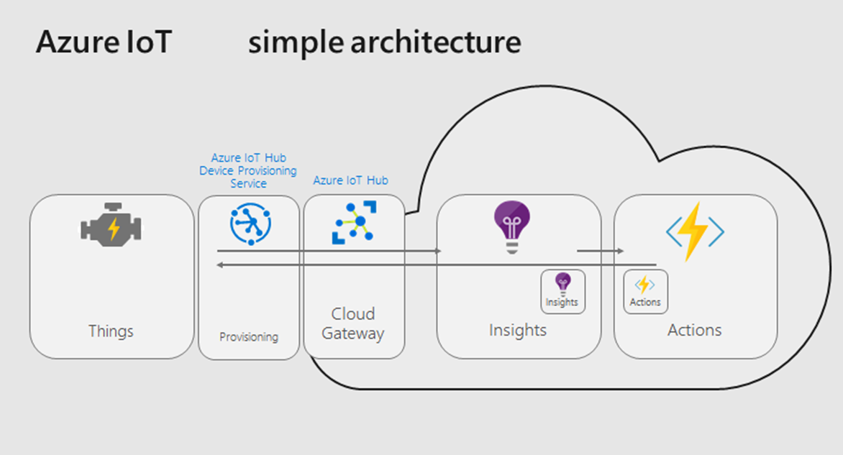

Slide 12
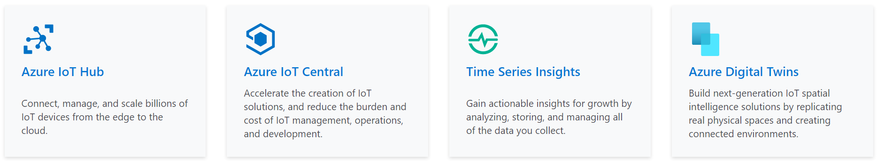
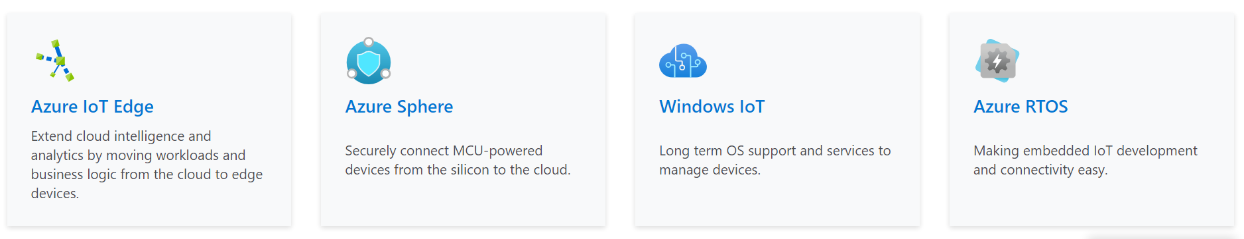
Azure IoT Product
Cloud
Device

Slide 13
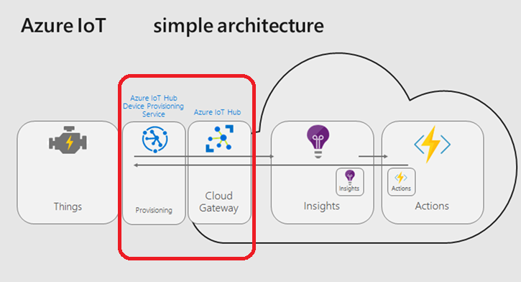

Slide 14
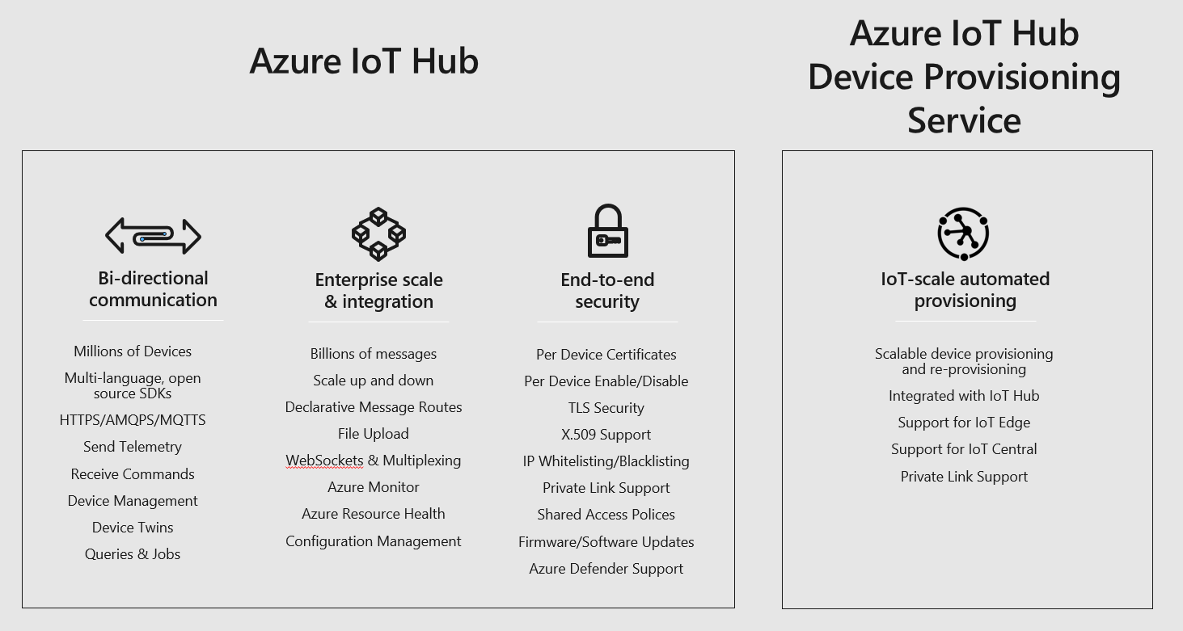

Slide 15
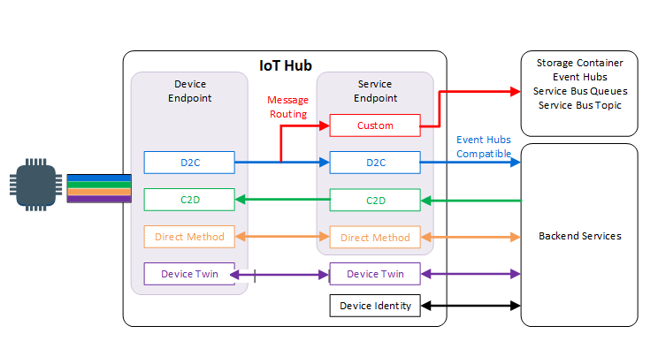

Slide 16
Demo
Notes:
Demonstrate Certification Portal, Device Catalog

Slide 17
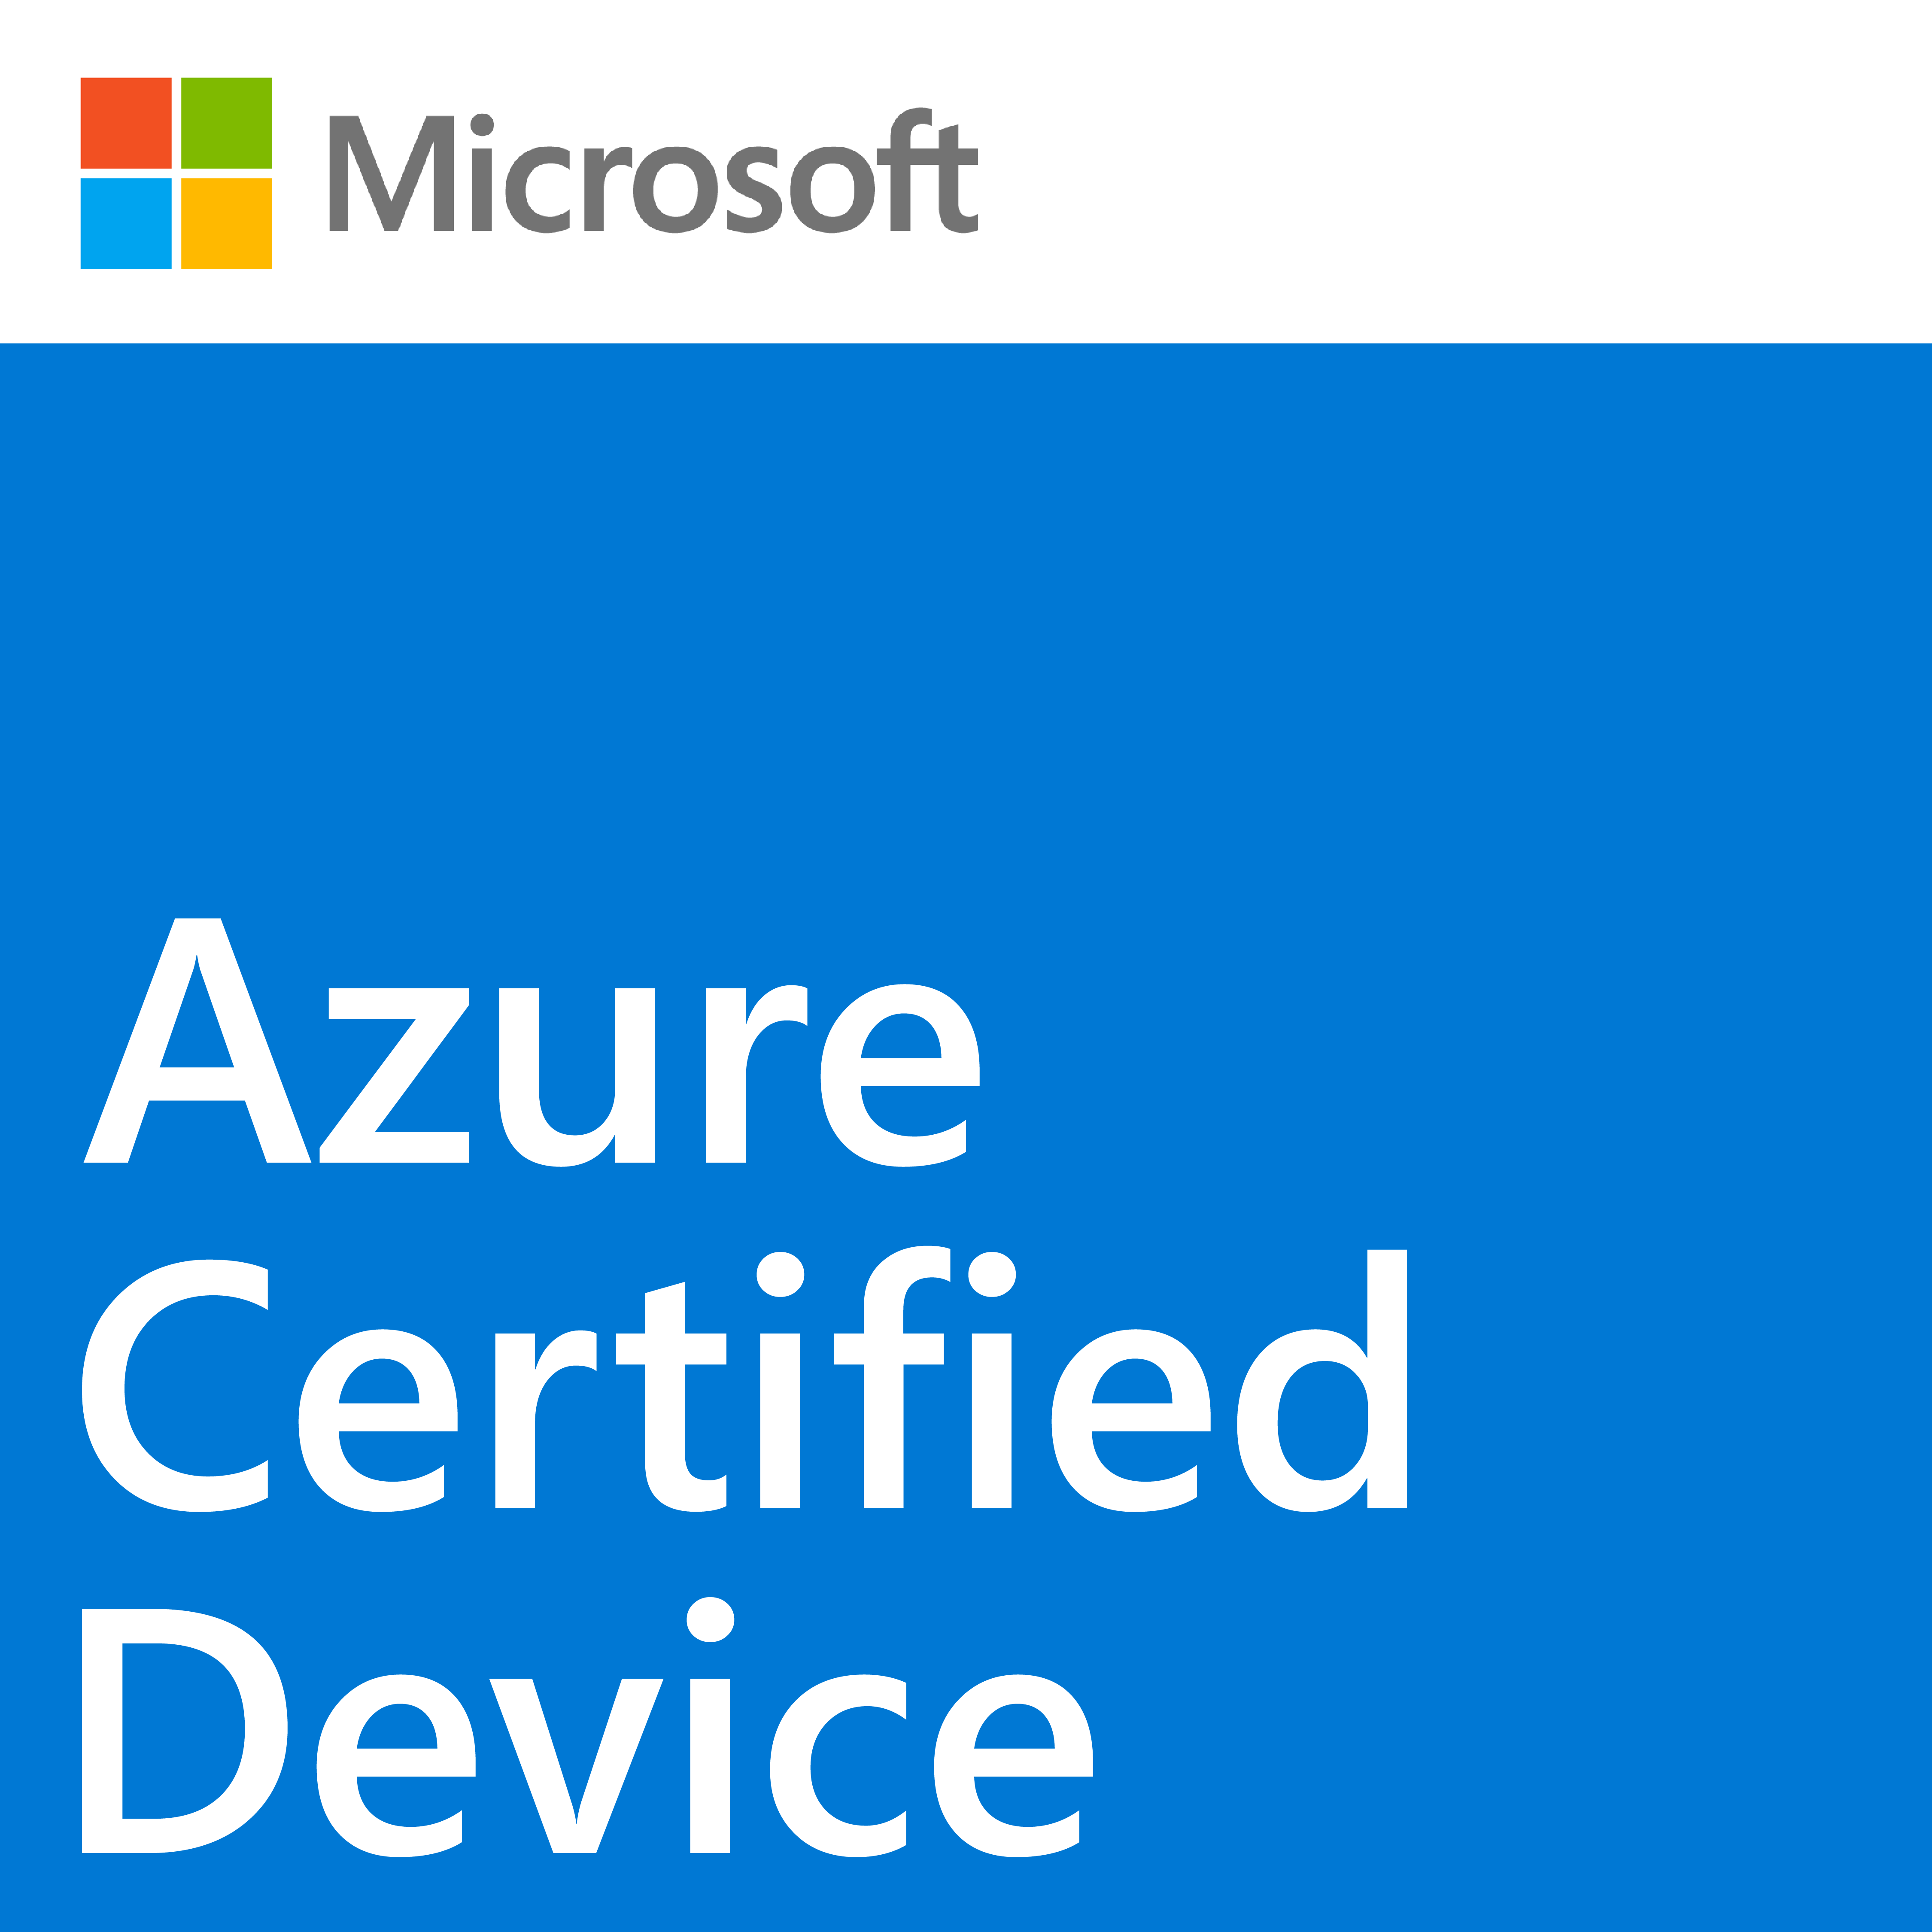

IoT Plug and Play process overview
❹ Certify device
Device Catalog
Enable IoT Plug and Play support to solutions
❸ Publish/share model definition
Model Repository
Device builder
Solution builder
❶ Author device model
Device model & interface definition
❷ Add model ID announcement to app
❷ Resolve Model
Model ID Announcement
❶ Retrieve model ID
Device app/firmware
IoT Plug and Play device app/firmware
IoT Hub
Solutions
Model ID
Model ID
Connect
Telemetry, property, command
Device model & interface definition
Model driven UI/UX
Partner components
Microsoft components
Plug and Play OP
Traditional OP
Notes:
Theme: Walk through developer experience
Device Builder
Author a device model with a unique DTMI ID
Implement Model ID announcement (minimum)
Make sure to follow IoT Plug and Play convention
Publish Device Model definition file
Certify device & publish to the device catalog
Solution Builder
Retrieve model id from IoT Hub
Resolve model from model repository
Drive UX/UI based on device model

Slide 18
Tools Demo
Notes:
Demonstrate Certification Portal, Device Catalog

Slide 19
Az iot command How to certify IoT Plug and Play devices | Microsoft Docs IoT explorer Install and use Azure IoT explorer | Microsoft Docs DTDL authoring tool Use a tool to author and validate DTDL models | Microsoft Docs

Slide 20

Microsoft
場地- Azure Device Catalog
行銷- Ignite,//Build, Inspire….
客人- Solution base on Azure
工具- Device SDK, Service SDK,Tools
Device Builder
專心於開發 IOT 裝置Device Capability
產品認證- Azure Certify Program

Slide 21
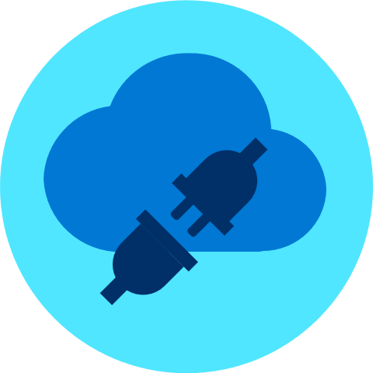
Thank you

